Slide 1
ETL Project hiv
John, Michelle, and Taoule

Slide 2
Project Details:
Extract: your original data sources and how the data was formatted (CSV, JSON, pgAdmin 4, etc).
Transform: what data cleaning or transformation was required.
Load: the final database, tables/collections, and why this was chosen.

Slide 3
Data Clean-up & analysis

Slide 4
Extraction:
Sources of Data
Data.world
CDC & NPIN ‘s HIV service provider website
Using web scraping tools the data was formatted into CSV’s
Libraries/Dependencies used included:
Pandas
Splinter
BeautifulSoup
SQL
Time

Slide 5
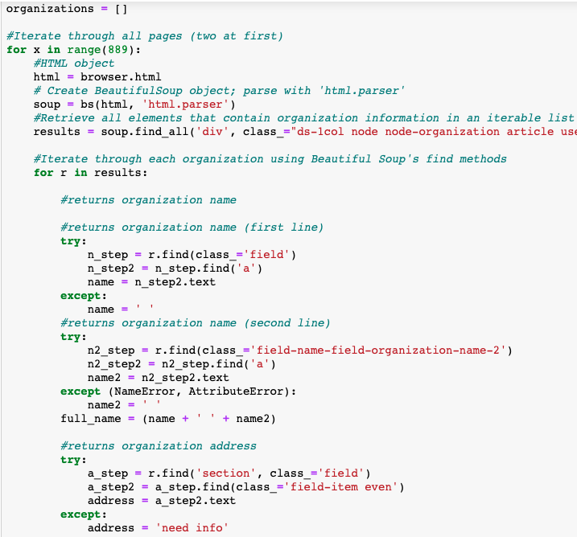
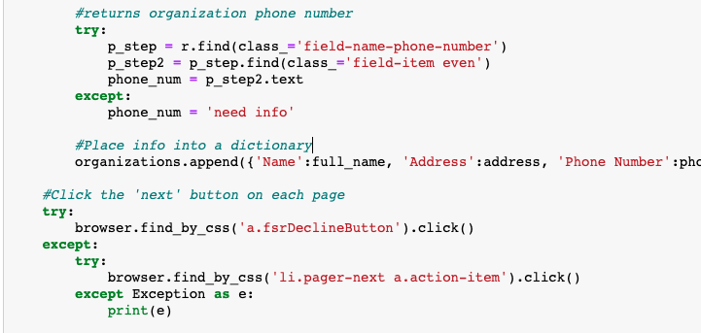
A nice long scrape…
After making connections to the web page and analyzing the html this is the main code that scraped through almost 900 pgs.
The browser.click() needed a try and except statement to get around a pop-up window that appears every so often. Also to signify the end of the scrape.
Still working on: A way to automate the range (number of pages) to scrape based on what the html. A scrape that pulls more information about the providers, what they offer, website, hours, etc..

Slide 6
Transformation:
Types needed for the data:
Clean
Filter
Merge
Filter
Edit text strings
Replace null values

Slide 7
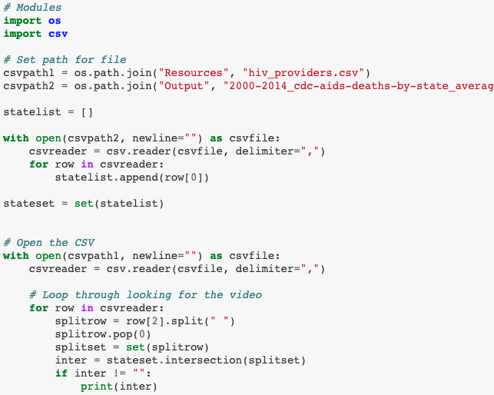
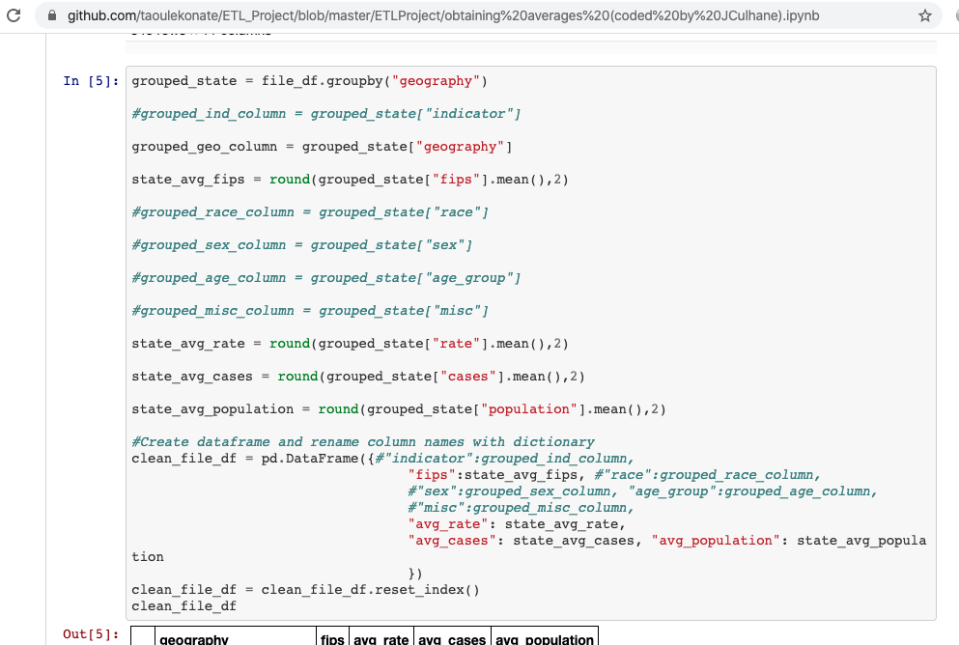
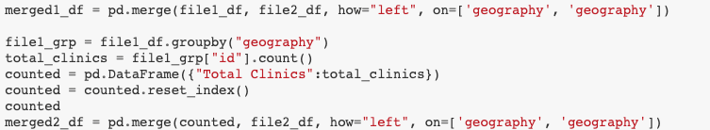
Obtain averages using groupby for rates, cases, and population
Merge the data to prepare to load the data to AWS

Slide 8
Load:
Final production database will be relational because:
Need to be able to do routine analysis of the data
Need to be capable of handling complex queries
Ability to keep up with the data and connect to other tables
Loaded to AWS
Final tables/collections were selected so that:
Comparisons between HIV death rates and numbers of services providers can be analyzed
Service providers information can be updated and added to
Future analyzation can be done as more info is added

